Slide 1


ClimeXplorer
About this Exploration!
ClimeXplorer—an engaging game-based learning experience designed to teach you all about climate change! Dive into interactive content that includes documentary videos, real-time weather data, insights into the impacts of climate change, and practical ways to combat it. Whether you're a student or just curious, ClimeXplorer makes learning about climate action both fun and educational!.

Slide 2
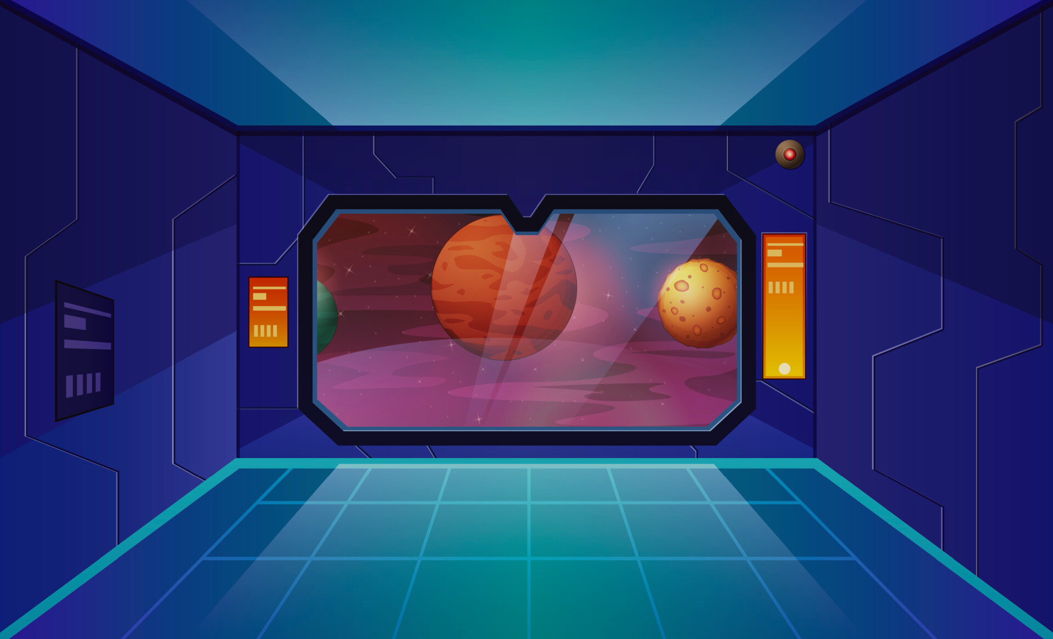
Problem
the complex nature of climate change can be overwhelming
Solution
This project addresses the challenge by breaking down its scientific principles into relatable, interactive scenarios, thereby demystifying concepts like greenhouse gasses, global temperature rise, radiative forcing, climate sensitivity, and mitigation strategies.

Slide 3
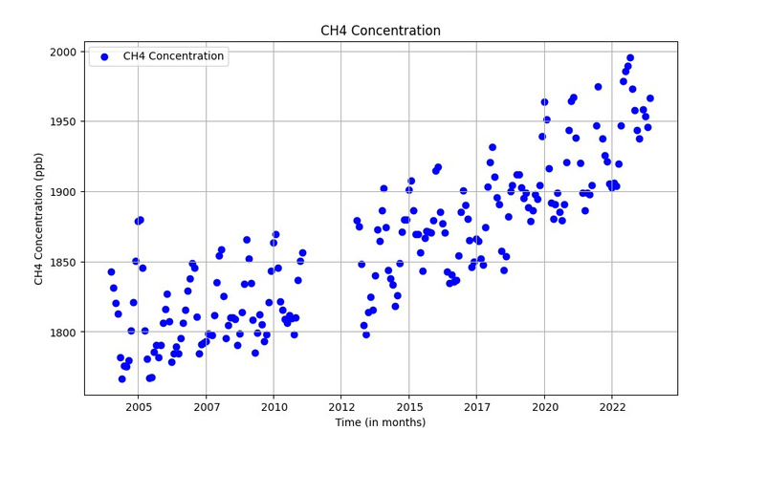
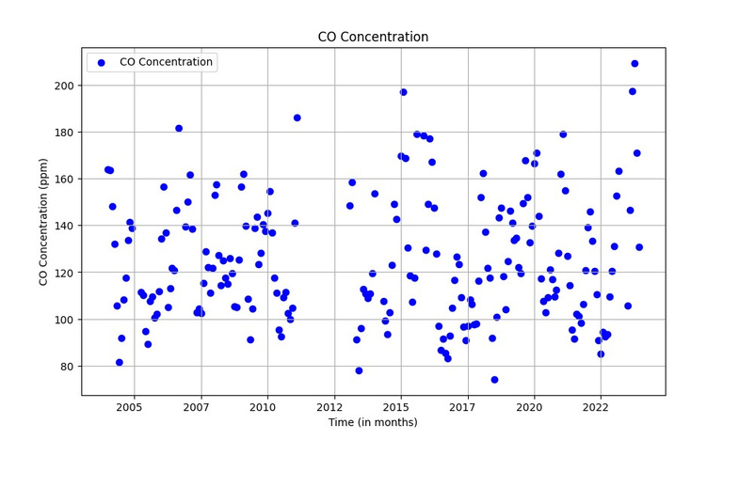
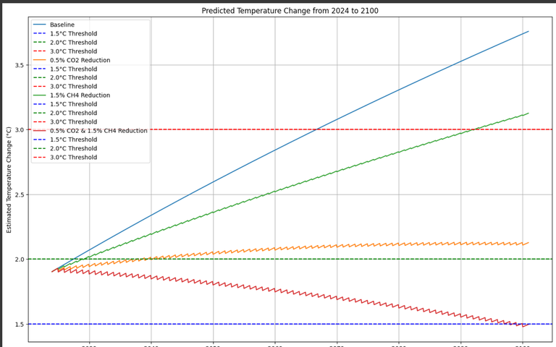
Data

Slide 4
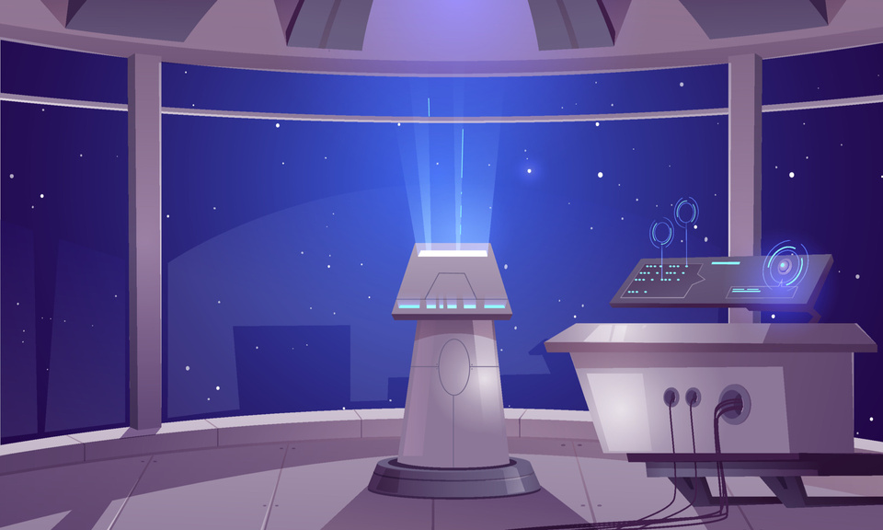


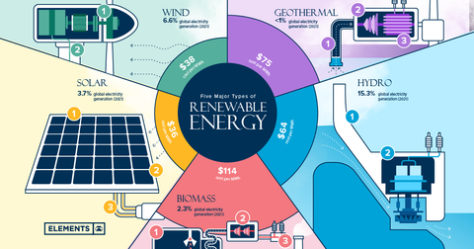




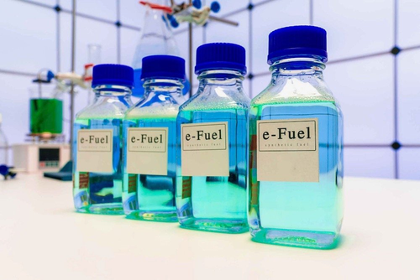




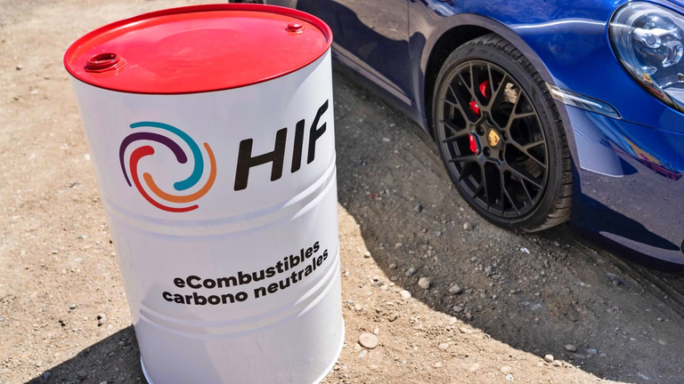
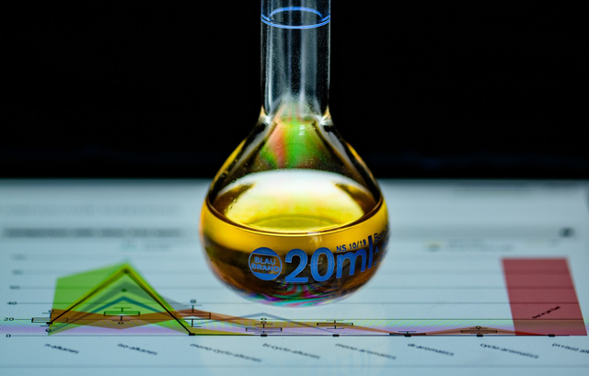
CONVERSATION
Renewable Energy
As you know, our R.E.C.H.A.R.G.E operation is a specialized movement that aims to decrease this climate change, with our target being a stable 1.5 degree celsius increase
Not at all! There’s so much more we can do with different types of renewable energy. Let me walk you through them
It can be turned into several useful products, such as carbonated drinks, stronger concrete for building, and even plastic items.
It can also be transformed into synthetic fuels.
Yes, of course. Synthetic fuels also known as e-fuels, made by combining CO2 with hydrogen. This type of fuels, create a cleaner alternative to traditional fuels.

Slide 5
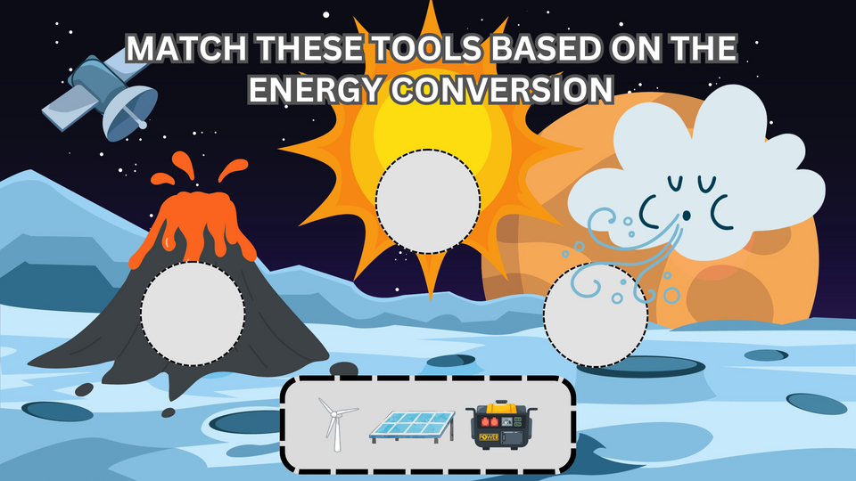
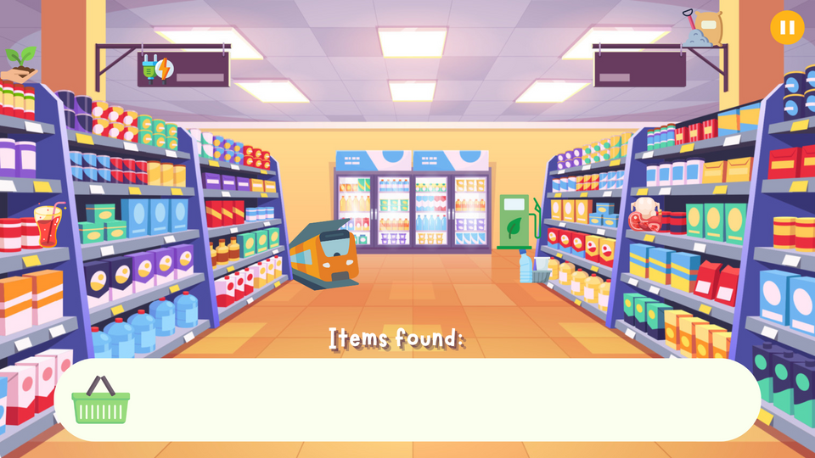

Mini Game

Slide 6
Credit
Video:
Al-jazeera
Kompas.com
newsflare
the guardian
Clickview
Photo:
Canva
Editing software:
Canva
Capcut
pixabay
youtube music studio
software:
Ren’py
Programming language:
python
Data:
NOAA

Slide 7
Refrences
Al‐Ghussain, L. (2018). Global warming: review on driving forces and mitigation. Environmental Progress & Sustainable Energy, 38(1), 13–21. https://doi.org/10.1002/ep.13041
Change, I. P. O. C. (2023). Climate Change 2021 - The Physical science basis: Working Group I Contribution to the Sixth Assessment Report of the Intergovernmental Panel on Climate Change.
Chen, H., & Chuang, Y. (2019). USING REN’PY AS A DIGITAL STORYTELLING TOOL TO ENHANCE STUDENTS’ LEARNING. PROCEEDINGS OF THE INTERNATIONAL CONFERENCE, 352–354. https://doi.org/10.33965/el2019_201909p053
Ciesla, R. (2019). Game Development with Ren’Py. In Apress eBooks. https://doi.org/10.1007/978-1-4842-4920-8
Consalvo, M., & Staines, D. (2020). Reading Ren’Py: Game Engine Affordances and design Possibilities. Games and Culture, 16(6), 762–778. https://doi.org/10.1177/1555412020973823

